Slide 1

BLUETOOTH CONTROLLED ROBOT CAR

Slide 2

PROBLEM STATEMENT
Traditional remote-controlled cars have limited range and flexibility, while wired systems restrict movement. A Bluetooth-controlled car using Arduino and an HC-05 module provides a cost-effective, wireless solution via smartphone control. However, challenges like signal interference, power consumption, and motor efficiency must be addressed for smooth and reliable operation. This project aims to develop an efficient, real-time controlled robotic car with potential for future automation.

Slide 3
ABSTRACT
This project focuses on designing a Bluetooth-controlled car using Arduino and the HC-05 module, enabling wireless operation via a smartphone. The car's movement is controlled through a mobile app, with commands transmitted via Bluetooth to an L298N motor driver, which regulates the DC motors. The system ensures a cost-effective, user-friendly, and flexible alternative to traditional remote-controlled cars. Future enhancements could include sensor integration for obstacle detection, voice control, and GPS-based navigation for autonomous functionality.

Slide 4
INTRODUCTION
The Bluetooth-controlled car is a wireless robotic vehicle operated via a smartphone app using the HC-05 Bluetooth module and Arduino. It utilizes an L298N motor driver to control DC motors, allowing smooth movement in different directions. This project provides a cost-effective and efficient alternative to traditional remote-controlled cars. It can be enhanced with sensor-based automation, voice commands, and GPS navigation for advanced applications in robotics and automation.

Slide 5
KEY FEATURES
Wireless Control: Operated via a smartphone using Bluetooth connectivity.
Arduino-Based System: Uses an Arduino Uno for efficient control and processing.
L298N Motor Driver: Controls the DC motors for smooth and precise movement.
Bidirectional Movement: Supports forward, backward, left, and right motions.
Easy to Use: Simple smartphone interface for seamless control.
Customizable: Can be enhanced with additional features like sensors, voice control, or GPS tracking.
Compact & Cost-Effective: Affordable and easy to build with readily available components.

Slide 6
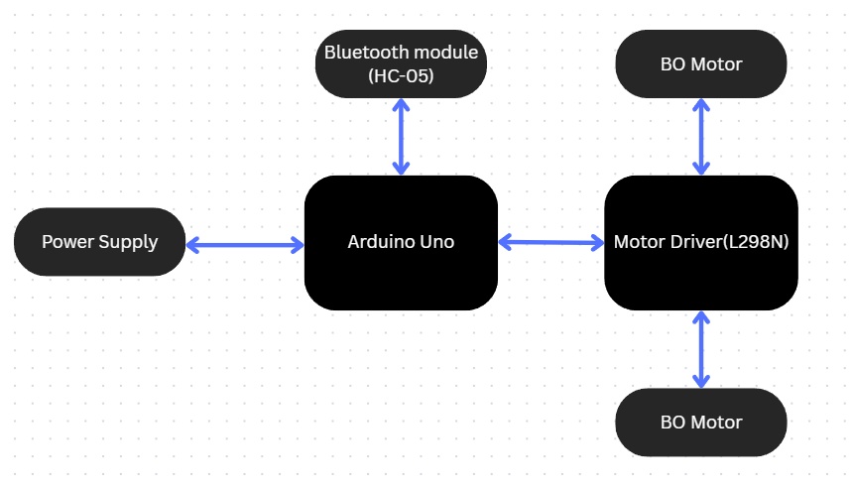
BLOCK DIAGRAM

Slide 7
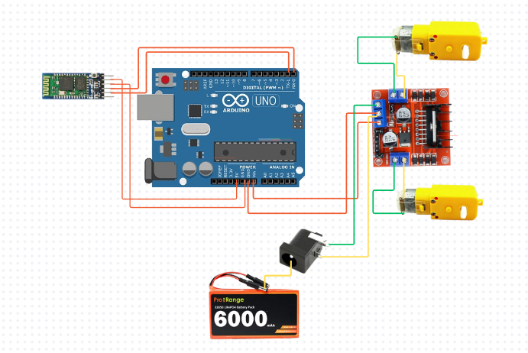
CIRCUIT DIAGRAM

Slide 8
USE CASES
Education & Learning – Teaches robotics, Arduino, and wireless control.
Surveillance & Security – Can be used for remote monitoring.
Disaster Management – Assists in search and rescue operations.
Smart Home Automation – Integrates with IoT for remote control.
Entertainment & Gaming – Used in DIY projects and RC racing.
Industrial & Agricultural Use – Helps in material transport and monitoring.

Slide 9
OUTCOME
Successful Wireless Control: The car can be controlled via a smartphone using Bluetooth.
Efficient Navigation: Smooth movement in all directions using the L298N motor driver.
Real-Time Response: Instant execution of commands with minimal delay.
User-Friendly Interface: Simple mobile app control for easy operation.
Hands-On Learning: Enhances knowledge of Arduino, motor drivers, and wireless communication.
Future Scope: Can be upgraded with sensors for obstacle avoidance, GPS tracking, or voice control

Slide 10
CONCLUSION
The Bluetooth-controlled car project successfully enables wireless control using a smartphone and an Arduino-based system. It demonstrates efficient motor control via the HC-05 Bluetooth module and L298N motor driver. This project enhances understanding of embedded systems and wireless communication and can be expanded with autonomous navigation and obstacle detection for advanced applications.

